Slide 1
How Financial Services Uses MongoDB
#MongoDB
Buzz Moschetti
buzz.moschetti@mongodb.com
Financial Services Enterprise Architect, MongoDB
Notes:
Hello all! This is Buzz Moschetti. Welcome to today’s webinar entitled “How Financial Serivces Uses MongoDB”
I am an Enterprise Architect and today I’m going to talk about some popular use cases involving mongoDB that we’ve seen emerge in Financial Services – that being wholesale & retail banking and insurance -- and the reasons that motivated the use of it.
First, some quick logistics:
The presentation audio & slides will be recorded and made available to you in about 24 hours.
We have an hour set up but I’ll use about 40 minutes of that for the presentation with some time for Q & A.
You can of course use the webex Q&A box to ask those questions at any time but I will hold off answering them until the end.
If you have technical issues, please send a webex chat message to the participant ID’d as mongoDB webinar team; otherwise keep your Qs focused on the content.

Slide 2


MongoDB
The leading NoSQL database
{
name: “John Smith”,
pfxs: [“Dr.”,”Mr.”],
address: “10 3rd St.”,
phone: {
home: 1234567890,
mobile: 1234568138 }
}
General Purpose
Document Data Model
Open-Source
Notes:
Acknowledging this may be new for some percentage of the audience, I’ll spend a few minutes doing an overview of mongoDB.
What is it?
It is a general purpose document store database.
General purpose means CRUD (create read update delete) works similar to traditional databases, esp. RDBMS. Content that is saved is immediately readable and indexed and available to query through a rich query language. This is major differentiator in the NoSQL space.
By document we mean a “rich shape” model: Not a word doc or a PDF. instead of forcing data into a normalized set of rectangles (a.k.a. tables), mongoDB can store shapes that contain lists and subdocuments: we see some hint of that here with the pfxs and phone fields and we’ll explore in just slightly more detail later on.
We are also OpenSource: there is a vibrant community that contributes to and amplifies the product and solutions around it. As a company, we provide value beyond the basic features including enterprise-ready features such as commercial grade builds, monitoring & management services, authentication security, support, training, and launch services.

Slide 3












MongoDB Company Overview
375+ employees
1000+ customers
Offices in NY & Palo Alto and
across EMEA, and APAC
Over $231 million in funding
(More than other NoSQL vendors combined)
Notes:
Here’s a little bit about us.
HQ in NY, we are 375 employees in eng, presales, consulting, documentation, and community support – and yes, sales too.
Actively supporting the mongoDB ecosystem are the people involved in the 7.2 million downloads of the product to date.

Slide 4























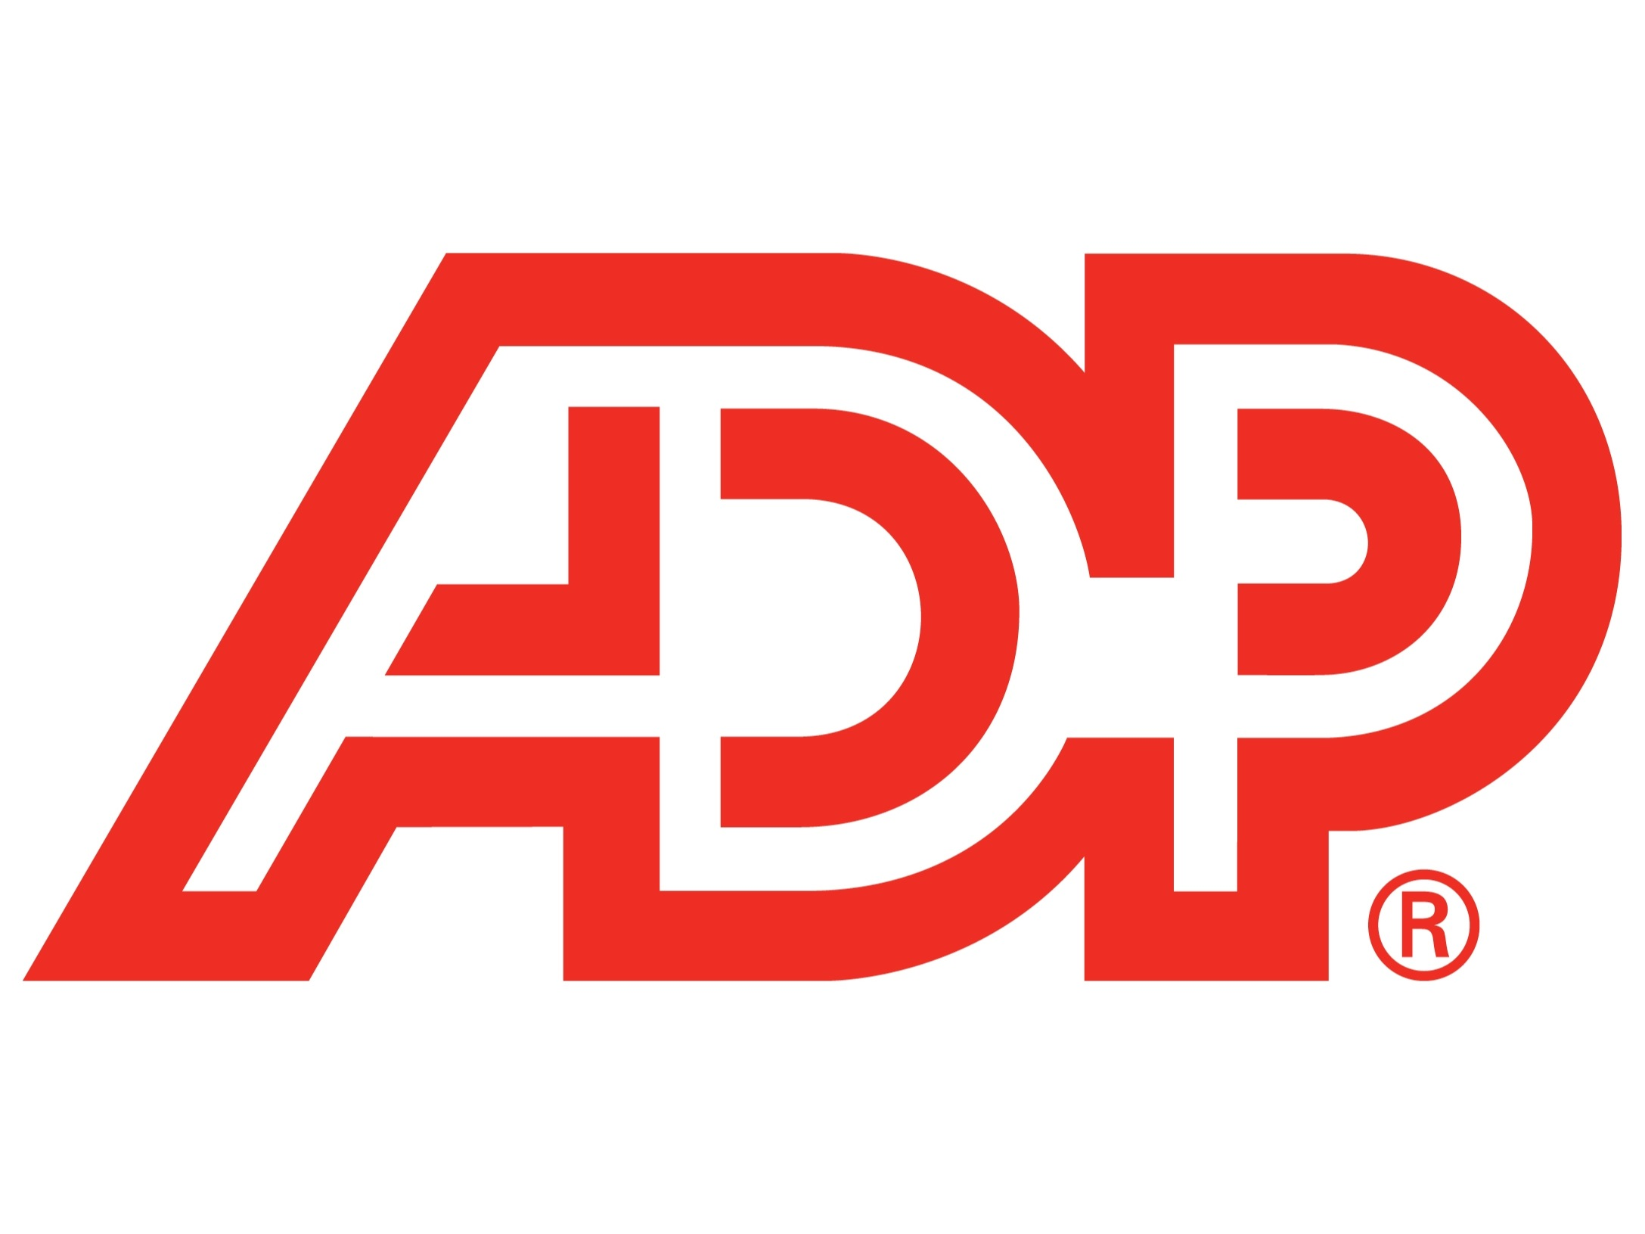



Leading Organizations Rely on MongoDB
Notes:
And here’s the logo page you’ve been waiting to see.
The 1000+ paying customers include most of the Fortune 500 and the top retail and wholesale banks in the country, and as you know banks are shy about their logos.
These customers span the spectrum of complexity and performance from small targeted solutions platforms to petabyte installations like CERN and the Large Hadron Collider and many billion document collections with high read/write workloads like craigslist and foursquare.

Slide 5



Leading NoSQL Database
Google Search
LinkedIn Job Skills
MongoDB
MongoDB
Jaspersoft Big Data Index
Indeed.com Trends
Direct Real-Time Downloads
MongoDB
Top Job Trends
HTML 5
MongoDB
iOS
Android
Mobile Apps
Puppet
Hadoop
jQuery
PaaS
Social Media
Notes:
And why do they use us? Well, for a number of reasons. Our document model and the technology around it is very good – but it’s more than the technology.
Not important to point out the names of our direct competitors here but in comparison we’re clearly the most popular and commercially vibrant NoSQL database, and the talent pool is growing.
The overall community is large enough that, for example, stackoverflow.com has a very active and useful forum for mongoDB and many questions on edge use cases and integration and best practices can be found there.
And this is reflected in….. (turn page).

Slide 6
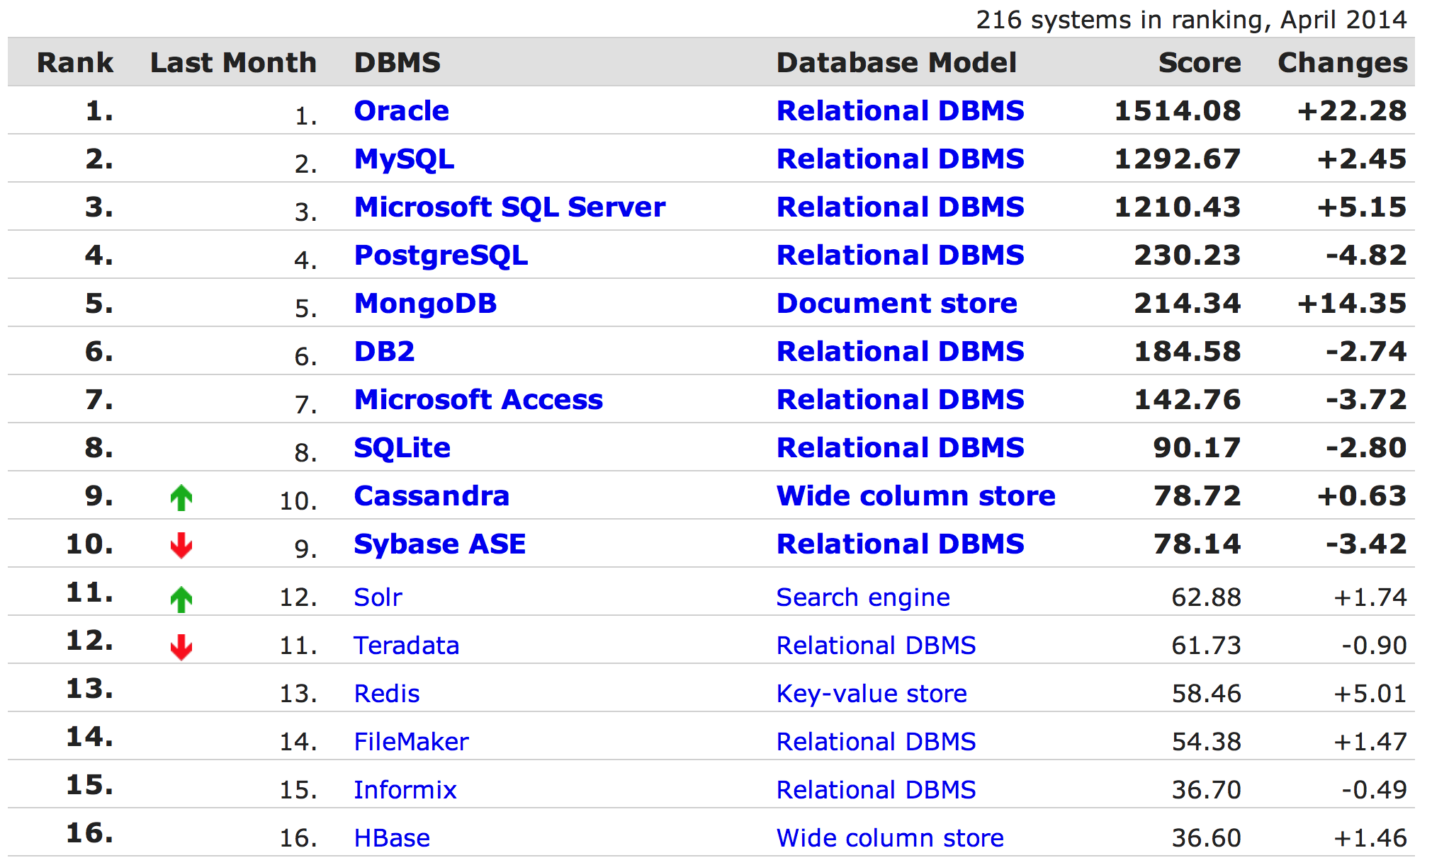
DB-Engines.com Ranks DB Popularity
Notes:
#5 most popular DB, measured by combination of use, awareness, and activity on the internet
Passed DB2 in Feb.
On track to pass postgres in a month or so.
From there quite a jump to the next tier but still a very good showing – and the only document / rich shape product on the radar.

Slide 7















MongoDB Partners (400+) & Integration
Software & Services
Cloud & Channel
Hardware
Notes:
Here’s another reason for the popularity and strength of the platform: We have 400 partners and growing by about 10 monthly. Much More than others in the NoSQL space.
We have strategic partnerships with progressive companies like Pentaho in BI and AppDynamics for system health and performance monitoring.
And we have certification programs for systems integrators too so you can outsource with confidence.
IBM: Standardizing on BSON, MongoDB query language, and MongoDB wire protocol for DB2 integration, and that sends a very strong signal about our position in this space. Just google for IBM DB2 JSON and you’ll see.
Historically, mongoDB is very cloud friendly and although financial services tend not to use public clouds as much due to personal info and data secrecy issues, the tools and techniques developed in the public clouds for provisioning, monitoring, multitenancy, etc. can be reproduced in private clouds inside your firewall so financial services can get a leg up on that so to speak.

Slide 8




MongoDB Business Value
Enabling New Apps
Better Customer Experience
Faster Time to Market
Lower TCO
Notes:
We enable new apps, personalized apps and data, through flexible and dynamic data capture, which leads to a better customer experience.
Technically, The product and the way it interacts with the software stack around it leads to faster time to market and lower TCO.

Slide 9
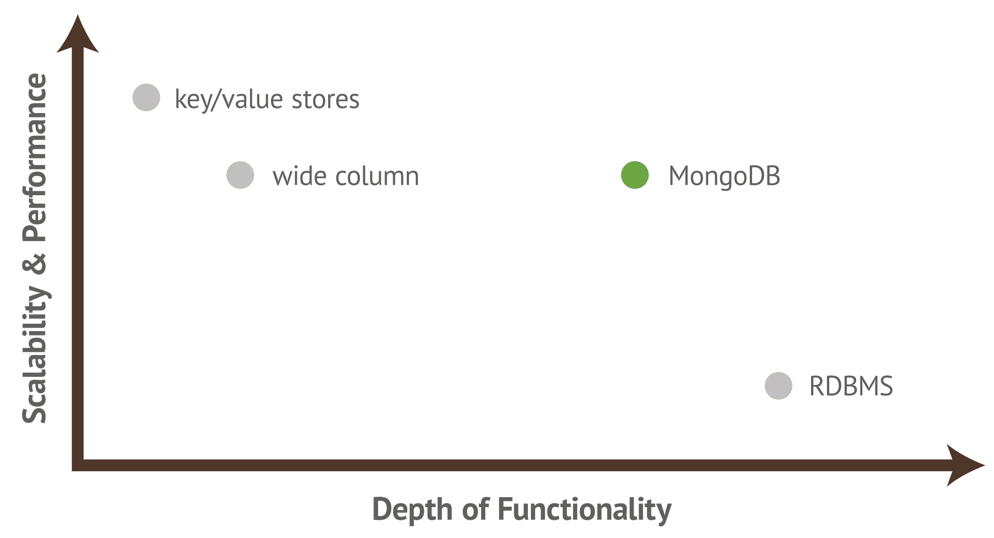
Operational Database Landscape
No Automatic Joins
Document Transactions
Fast, Scalable Read/Writes
Notes:
Let’s examine where the technology is positioned.
Here are a few of the most popular types of persistence models in use today.
RDBMS, being the most mature, are deep in functionality – but the legacy design principles are rooted on design principles almost 40 years old. And that comes at the expense of rich interaction with today’s programming languages, design requirements, and infrastructure implementation choices.
Key-value stores, at the other end of the spectrum, act essentially like HashMaps (for those Java programmers in the audience) but are not really general purpoise databases.
MongoDB trades some features of a relational database (joins, complex transactions) to enable greater scalability, flexibility, and performance for purpose. By that we mean performance for the operations as executed at the data access layer, not necessarily TPS at the database level.

Slide 10
Relational: ALL Data is Column/Row
Customer ID | First Name | Last Name | City
0 | John | Doe | New York
1 | Mark | Smith | San Francisco
2 | Jay | Black | Newark
3 | Meagan | White | London
4 | Edward | Daniels | Boston
Phone Number | Type | DoNotCall | Customer ID
1-212-555-1212 | home | T | 0
1-212-555-1213 | home | T | 0
1-212-555-1214 | cell | F | 0
1-212-777-1212 | home | T | 1
1-212-777-1213 | cell | (null) | 1
1-212-888-1212 | home | F | 2
Notes:
To compare RDBMS and document modeling, let’s take a simple example of phone numbers for a particular customer.
Even for simple structures – a list of phone number within a customer – the data is split across 2 tables.
What are the consequences?
Managing relationship between customer and phones is non-trivial
This case is the friendly one because the same ID for the customer table is used for phones; that is not always the case, and separate foreign keys must be created and assigned o both tables.
Of course, be mindful of customers WITHOUT phones because this changes common JOIN relationships!
This approach clearly gets more complicated the more “subentities” exist for a particular design – especially those involving lists of plain scalar values
phone_0, phone_1
value_0, value_1, etc.

Slide 11
mongoDB: Model Your Data The Way it is Naturally Used
Relational
MongoDB
{ customer_id : 1,
first_name : "Mark",
last_name : "Smith",
city : "San Francisco",
phones: [ {
number : “1-212-777-1212”, dnc : true,
type : “home”
},
{
number : “1-212-777-1213”,
type : “cell”
}]
}
Customer ID | First Name | Last Name | City
0 | John | Doe | New York
1 | Mark | Smith | San Francisco
2 | Jay | Black | Newark
3 | Meagan | White | London
4 | Edward | Daniels | Boston
Phone Number | Type | DNC | Customer ID
1-212-555-1212 | home | T | 0
1-212-555-1213 | home | T | 0
1-212-555-1214 | cell | F | 0
1-212-777-1212 | home | T | 1
1-212-777-1213 | cell | (null) | 1
1-212-888-1212 | home | F | 2
Notes:
In mongoDB, you model your data the way it is naturally associated
Lists of things remain lists of things
No extra steps with foreign keys

Slide 12
No SQL But Still Flexible Querying
Rich Queries
Find everybody who opened a special account last month in NY between $100 and $1000 OR last year more than $500
Aggregation
What is the average P&L of the trading desks grouped by a set of date ranges
Text Search
Find all tweets that mention the bank within the last 2 days
Geospatial
Find all customers that live within 10 miles of NYC
Calculate total amount settled position by symbol by settlement venue
Map Reduce
Notes:
Just because mongoDB is NoSQL does not mean it is without application-friendly features that are required for a general purpose database
Rich Queries and Aggregation are “expected” functions of a database and mongoDB has powerful offerings for both, complete with primary and secondary index support.
Text, Geo, and MapReduce are extended features of the platform.
NOW – let’s move on to use cases within financial serivces

Slide 13
Capital Markets – Common Uses
Functional Areas | Use Cases to Consider
Risk Analysis & Reporting | Firm-wide Aggregate Risk Platform Intraday Market & Counterparty Risk Analysis Risk Exception Workflow Optimization Limit Management Service
Regulatory Compliance | Cross-silo Reporting: Volker, Dodd-Frank, EMIR, MiFID II, etc. Online Long-term Audit Trail Aggregate Know Your Customer (KYC) Repository
Buy-Side Portal | Responsive Portfolio Reporting
Trade Management | Cross-product (Firm-wide) Trademart Flexible OTC Derivatives Trade Capture
Front Office Structuring & Trading | Complex Product Development Strategy Backtesting Strategy Performance Analysis
Reference Data Management | Reference Data Distribution Hub
Market Data Management | Tick Data Capture
Investment Advisory | Cross-channel Informed Cross-sell Enriched Investment Research
Notes:
Again, we consider Financial Services to be capital markets, retail, and insurance.
Starting with cap mkts, here is a summary of use cases we have developed with customers.
I won’t read through these because you can peruse them at your leisure after the webinar.
Broad swath of areas covered from front to back office.
Of note: Strong cross-asset theme
As we move forward, we’ll see some some common patterns emerging from these specific uses, across all financial services.

Slide 14
Retail Banking - Common Uses
Functional Areas | Use Cases to Consider
Customer Engagement | Single View of a Customer Customer Experience Management Responsive Digital Banking Gamification of Consumer Applications Agile Next-generation Digital Platform
Marketing | Multi-channel Customer Activity Capture Real-time Cross-channel Next Best Offer Location-based Offers
Risk Analysis & Reporting | Firm-wide Liquidity Risk Analysis Transaction Reporting and Analysis
Regulatory Compliance | Flexible Cross-silo Reporting: Basel III, Dodd-Frank, etc. Online Long-term Audit Trail Aggregate Know Your Customer (KYC) Repository
Reference Data Management | [Global] Reference Data Distribution Hub
Payments | Corporate Transaction Reporting
Fraud Detection | Aggregate Activity Repository Cybersecurity Threat Analysis
Notes:
Retail, with a far larger direct customer base, brings 360 degree view of the customer with respect to internal (possibly legacy) systems together with modern and exciting concepts such as mobile deployment, alternative rewards programs, and rapid feature-trend development. This is very top-side kind of activity..
Interestingly, it also focuses on the back end – trade surveillance, risk, threat detection, and other fairly serious sounding and important activities!
You can see that many of the use cases are similar to capital markets.

Slide 15
Insurance – Common Uses
Functional Areas | Use Cases to Consider
Customer Engagement | Single View of a Customer Customer Experience Management Gamification of Applications Agile Next-generation Digital Platform
Marketing | Multi-channel Customer Activity Capture Real-time Cross-channel Next Best Offer
Agent Desktop | Responsive Customer Reporting
Risk Analysis & Reporting | Catastrophe Risk Modeling Liquidity Risk Analysis
Regulatory Compliance | Online Long-term Audit Trail
Reference Data Management | [Global] Reference Data Distribution Hub Policy Catalog
Fraud Detection | Aggregate Activity Repository
Notes:
Insurance is similar to Retail Banking – large direct customer base, 360 degree view of the customer and marketing / distribution channel optimization capabilities,
Many of the same themes: data consolidation, historical preservation of activity, and cross-asset flexible risk modeling.
In particular, the client-view integration of P&C, life, annuities, and other offerings across what was traditionally very separate aspects of the business (and therefore very separate systems) has had profound effects on the technology, customer relationship management, and targeted business growth.

Slide 16
Data Consolidation Challenge: Aggregation of disparate data is difficult
Issues
Yesterday’s data
Details lost
Inflexible schema
Slow performance
Cards
Datamart
Cards
Data Source 1
Batch
Batch
Datamart
Data Warehouse
Loans
Batch
Reporting
Loans
Batch
Data Source 2
…
Batch
Impact
What happened today?
Worse customer satisfaction
Missed opportunities
Lost revenue
Deposits
Datamart
Deposits
Data Source n
Batch
Notes:
Let’s get to the heart of it and examine four use case patterns in detail. Pretty much all of the use cases described in the past few pages can be described in a few patterns, which is good architecture.
The patterns are Data Consolidation, Point-Of-Origin, Reference Data Distribution, and Tick Data Management
Starting with Data Consolidation:
Most solutions look like this. Data on the left goes through a series of “processing steps” – and we’ll look at THAT in a moment – and ends up in a giant warehouse.
Why has this been a problem historically?
Largely because of 2 points: Details lost or obscured and inflexible schema to adapt to change. It’s hard enough for the feeder systems to manage their schemas; what happens when everything is brought together into a warehouse? More often than not, you end up with the giant 1000 table data warehouse.
In addition to the Impact points above, this overall design is more expensive than it needs to be especially when you factor in testing regions. Q/A must be ferocious here to ensure that the data is moving left to right smoothly.

Slide 17

Data Consolidation Solution: Using rich, dynamic schema and easy scaling
Cards
Operational Data Hub
Benefits
Real-time
Complete details
Agile
Higher customer retention
Increase wallet share
Proactive exception handling
Cards
Data Source 1
Trading Applications
Real-time or
Batch
Risk applications
Loans
Loans
Data Source 2
Operational Reporting
…
Deposits
Data Warehouse
Strategic Reporting
Deposits
Data Source n
Notes:
At least from a powerpoint view, the mongoDB solution looks similar. Perhaps comfortably so!
So what is different here? What makes a mongoDB hub different than an RDBMS hub? Did we simply drop a green leaf into the picture and raise the victory flag? Couldn’t we realtime enable the RDBMS hub and skip the datamarts and get to a picture that looks like this? Well clearly you could do those things but that’s NOT the critical issue here.
The real issue lies in dynamic schema and low-cost horizontal scaling
Dynamic schema allows the feeder systems to drive the data types and the overall shape of the data instead of having to “reinterpret” this information on the hub
Horizontal scaling means your hub can grow from 10GB to 10TB or more with consistent performance and operational integrity and management including resiliency (HA) and DR (esp multi data center recovery).
On other words, even if you eliminate the marts and make the hub realtime, you will likely end up with a 1000 table, brittle, hard to change data hub.

Slide 18
Data Consolidation Watch Out For The Arrow!
Traditional Approach
Data Source 1
Flat Data
Extractor
Program
Potentially
Many CSV
Files
Flat Data Loader
Program
Data Mart Or Warehouse
App
Entities in source RDBMS not extracted as entities
CSV is brittle with no self-description
Both Loader and RBDMS must update schema when source changes
Application must reassemble Entities
The mongoDB Approach
Data Source 1
JSON
Extractor
Program
App
Fewer
JSON
Files
Entities in RDBMS extracted as entities
JSON is flexible to change and self-descriptive
mongoDB data hub does not change when source changes
Application can consume Entities directly
Notes:
It’s all about The Arrow. The arrow is the single most misleading thing in architecture diagrams today.
The “arrow” represents MUCH more than just “data in A going to B.”
In the traditional approach, almost from the get-go, data is extracted from the RDBMS into CSV or via ETL and immediately begins to lose fidelity. If you think back to the Customer and Phones example before, instead of extracting a complete customer entity, we likely will get two sets of files or worse – a lossy blend that perhaps only provide the first phone number!
After the extract, the loader and the target RDBMS have to have the right schema in place and good luck to an application trying to re-engineer the relationship between some of these things especially as the data shapes change. We all know what happens to CSV based environments when data changes – and that is to make a NEW feed.
In the mongoDB approach, the feeder system can extract entities in as much fidelity and richness of shape as appropriate. Because JSON is self-descriptive, new fields and indeed, complete new substructures can be added without changing the feed environment OR THE TARGET mongoDB HUB!

Slide 19
Data Consolidation Case Study: Insurance
Insurance leader generates coveted 360-degree view of customers in 90 days – “The Wall”
Problem
Why MongoDB
Results
No single view of customer
145 yrs of policy data, 70+ systems, 15+ apps
2 years, $25M in failing to aggregate in RDBMS
Poor customer experience
Agility – prototype in 9 days;
Dynamic schema & rich querying – combine disparate data into one data store
Hot tech to attract top talent
Production in 90 days with 70 feeders
Unified customer view available to all channels
Increased call center productivity
Better customer experience, reduced churn, more upsell opps
Dozens more projects on same data platform
Notes:
One of prouder moments
First feeder systems were plumbed in ONE MONTH

Slide 20
Data Consolidation Case Study: Global Broker Dealer
Trade Mart for all OTC Trades
Problem
Why MongoDB
Results
Each application had its own persistence and audit trail
Wanted one unified framework and persistence for all trades and products
Needed to handle many variable structures across all securities
Dynamic schema: can save trade for all products in one data service
Easy scaling: can easily keep trades as long as required with high performance
Fast time-to-market using the persistence framework
Store any structure of products/trades without changing a schema
One consolidated trade store for auditing and reporting
* Same Concepts Apply to Risk Calculation Consolidation
Notes:
Risk!

Slide 21
Data Consolidation Case Study: Heavily Mergered Bank
Entitlements Reconciliation and Management
Problem
Why MongoDB
Results
Entitlement structure from 100s of systems cannot be remodeled in a central store
Difficult to design a difference engine for bespoke content
Feeder systems need to change on demand and cannot be held up by central store
Dynamic schema: Common bookkeeping plus bespoke content captured in same, queryable collection
Rich structure API allows generic, granular, and clear comparison of documents
Central processing places few demands on feeders
New systems can be added at any time with no development effort
Development effort shifted to value-add capabilities on top of store

Slide 22
Point-of-Origin Case Study: Global Broker Dealer
Structured Products Development & Pricing
Problem
Why MongoDB
Results
Need agility in design and persistence of complex instruments
Variety of consumers: C# front ends, Java and C++ backend calculators, python RAD
Arbitrary grouping of instruments in RDBMS is limited
Rich structure in documents supports legs of exotic shapes
13 languages supported plus more in the community
Faster development of high-margin products
Simpler management of portfolios and groupings
Notes:
Twist on the model: Instead of multiple shapes flowing into a mongoDB store, the mongoDB store is the point-of-origin for rich shapes.

Slide 23
Reference Data Distribution Challenge: Ref data difficult to change and distribute
Batch
Batch
Golden Copy
Batch
Batch
Batch
Common issues
Hard to change schema of master data
Data copied everywhere and gets out of sync
Impact
Process breaks from out of sync data
Business doesn’t have data it needs
Many copies creates more management
Batch
Batch
Batch
Notes:
Compared to distributed cache - $ and fixed schema

Slide 24

Reference Data Distribution Solution: Persistent dynamic cache replicated globally
Real-time
Real-time
Real-time
Real-time
Real-time
Solution:
Load into primary with any schema
Replicate to and read from secondaries
Benefits
Easy & fast change at speed of business
Easy scale out for one stop shop for data
Low TCO
Real-time
Real-time
Real-time

Slide 25
Reference Data Distribution Case Study: Global Bank
Distribute reference data globally in real-time for fast local accessing and querying
Problem
Why MongoDB
Results
Delays up to 36 hours in distributing data by batch
Charged multiple times globally for same data
Incurring regulatory penalties from missing SLAs
Had to manage 20 distributed systems with same data
Dynamic schema: easy to load initially & over time
Auto-replication: data distributed in real-time, read locally
Both cache and database: cache always up-to-date
Simple data modeling & analysis: easy changes and understanding
Will avoid about $40,000,000 in costs and penalties over 5 years
Only charged once for data
Data in sync globally and read locally
Capacity to move to one global shared data service

Slide 26
Tick Data Capture & Management Challenge: Huge volume, fast moving, niche technology
Issues
Bespoke technology (incl. APIs, ops, scalability) for each use case
High-performance tick solutions are expensive
Shallow pool for skills
Technology A
EOD Price Data
(10,000 rows)
EOD Applications
X
Symbol X Date
Applications
X
Hybridized
Technology X
Aggregation
Applications
Impact
Total Expense plus integration saps margin in product space
Technology B
Tick
Applications
RT Tick Data
(150,000 ticks/sec)
Notes:
Many stores: Relational, tick, flat files, caches…
RT Tick data is 150,000 X 3600 X 12 X 10 bytes = ~64GB per day (many tens of GB per day)

Slide 27
Tick Data Capture & Management Solution: Sharding and tick bucketing & compression
Benefits
Common technology platform
Common DAL for many use cases / workloads
Affordable but still high performance horizontal scalability
EOD Applications
RT Tick Data
Python DAL
Bucket /
Compression
Unbucket /
Decompression
Symbol X Date
Applications
pymongo driver
Aggregation
Applications
mongoDB Sharded Cluster
Tick
Applications
Notes:
10 years of 1 minute data < 1 s
200 inst X all history X EOD price < 1s

Slide 28
Tick Data Capture & Management Case Study: Systematic Trading Group
Common infrastructure for multiple access scenarios of tick data
Problem
Why MongoDB
Results
Quants demand agility in python
Quant use cases have very different workload than traders
Reticence to invest in highly specialized languages and ops
Excellent impedance match to python
High, predictable read/write performance
Ability to easily store long vectors of data
Rich querying and indexing can be exploited by a custom DAL
Platform can ingest 130mm ticks/second
10 years of 1 minute data < 1 s
200 inst X all history X EOD price < 1s
Much lower TCO
Easier hiring of talent
Notes:
Sharding on market and symbol
Results:
Once a day data: 4ms for 10,000 rows
READ: 230m ticks/sec via 256 parallel readers
10-15x reduction in network load and negligible decompression (lz4: 1.8Gb/s)
Other things can be stored in mongoDB!

Slide 29
MongoDB World New York City, June 23-25
#MongoDBWorld
See how Citigroup, Stripe, Carfax, Expedia and others are engineering the next generation of data with MongoDB
http://world.mongodb.com
Save 25% with discount code 25mk

Slide 30

Webinar Q&A buzz.moschetti@mongodb.com http://world.mongodb.com Save 25% with discount code 25mk

Slide 31
Thank You

